Slide 1
Wireless Sensor Networks
Introduction
1-<number>

Slide 2
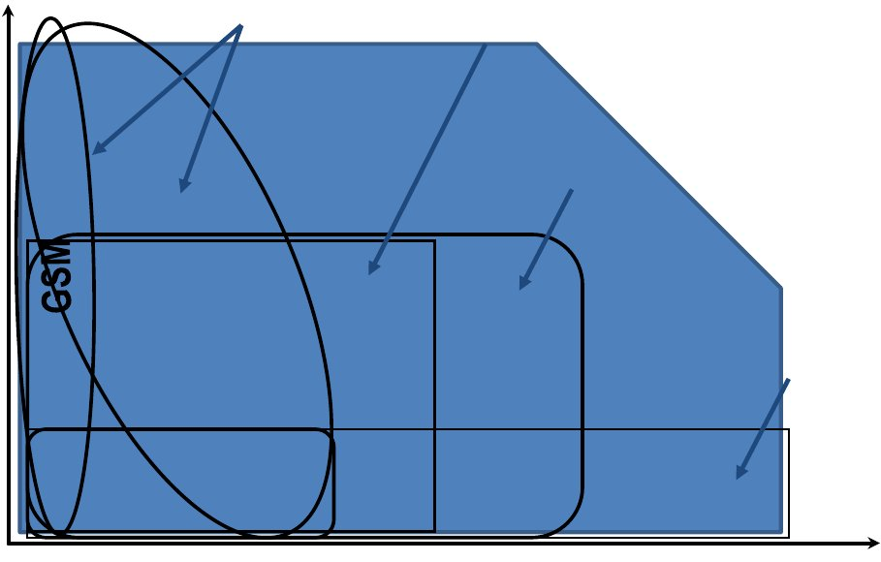
Wireless Standards
Mobility
WAN
WLAN
Vehicle
Walk
LTE-A
Outdoor
High performance WLAN
UMTS
Fixed
802.11b
802.11a/g
Wired LAN
Walk
Fixed/
Desktop
Indoor
Bluetooth
0,1
1
10
100
1000
Mbps (PHY layer)

Slide 3
Wireless and Mobile Networks
Background:
# wireless (mobile) phone subscribers now exceeds # wired phone subscribers (5-to-1)!
# wireless Internet-connected devices equals # wireline Internet-connected devices
  laptops, Internet-enabled phones promise anytime untethered Internet access
two important (but different) challenges
  wireless: communication over wireless link
  mobility: handling the mobile user who changes point of attachment to network

Slide 4



















Elements of a wireless network
network
infrastructure

Slide 5
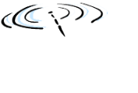


Elements of a wireless network
wireless hosts
laptop, smartphone
run applications
may be stationary (non-mobile) or mobile
  wireless does not always mean mobility
network
infrastructure

Slide 6

Elements of a wireless network
base station
typically connected to wired network
relay - responsible for sending packets between wired network and wireless host(s) in its “area”
  e.g., cell towers, 802.11 access points
network
infrastructure

Slide 7
Elements of a wireless network
wireless link
typically used to connect mobile(s) to base station
also used as backbone link
multiple access protocol coordinates link access
various data rates, transmission distance
network
infrastructure

Slide 8
Elements of a wireless network
infrastructure mode
base station connects mobiles into wired network
handoff: mobile changes base station providing connection into wired network
network
infrastructure

Slide 9


Elements of a wireless network
ad hoc mode
no base stations
nodes can only transmit to other nodes within link coverage
nodes organize themselves into a network: route among themselves

Slide 10
Wireless network taxonomy
single hop
multiple hops
host connects to
base station (WiFi,
WiMAX, cellular)
which connects to
larger Internet
host may have to
relay through several
wireless nodes to
connect to larger
Internet: mesh net
infrastructure
(e.g., APs)
no base station, no
connection to larger
Internet. May have to
relay to reach other
a given wireless node
MANET, VANET
no
infrastructure
no base station, no
connection to larger
Internet (Bluetooth,
ad hoc nets)

Slide 11
Wireless Link Characteristics (1)
important differences from wired link ….
  decreased signal strength: radio signal attenuates as it propagates through matter (path loss)
  interference from other sources: standardized wireless network frequencies (e.g., 2.4 GHz) shared by other devices (e.g., phone); devices (motors) interfere as well
  multipath propagation: radio signal reflects off objects ground, arriving ad destination at slightly different times
…. make communication across (even a point to point) wireless link much more “difficult”

Slide 12
Wireless Link Characteristics (2)
SNR: signal-to-noise ratio
  larger SNR – easier to extract signal from noise (a “good thing”)
SNR versus BER tradeoffs
  given physical layer: increase power -> increase SNR->decrease BER
  given SNR: choose physical layer that meets BER requirement, giving highest thruput
    SNR may change with mobility: dynamically adapt physical layer (modulation technique, rate)
10⁻¹
10⁻²
10⁻³
BER
10⁻⁴
10⁻⁵
10⁻⁶
10⁻⁷
10
20
30
40
SNR(dB)
QAM256 (8 Mbps)
QAM16 (4 Mbps)
BPSK (1 Mbps)

Slide 13
The Multiple Access Problem
• The base stations need to serve many mobile
terminals at the same time (both downlink
and uplink)
• All mobiles in the cell need to transmit to the
base station
• Interference among different senders and
receivers
• So we need multiple access scheme, to control
transmissions from/to mobile terminals

Slide 14
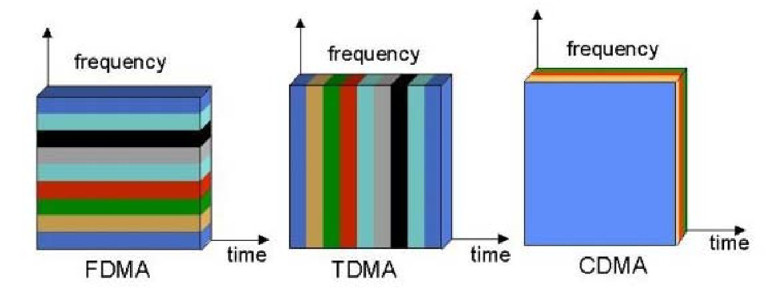
Multiple Access Schemes
3 orthogonal Schemes:
• Frequency Division Multiple Access (FDMA)
• Time Division Multiple Access (TDMA)
• Code Division Multiple Access (CDMA)

Slide 15
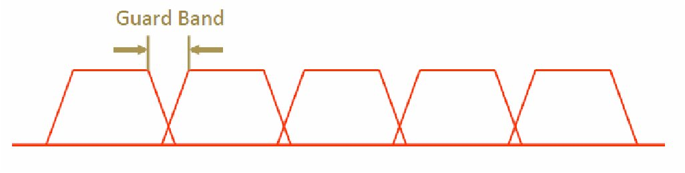
Frequency Division Multiple Access
frequency
• Each mobile is assigned a separate frequency channel for the
duration of the call
• Sufficient guard band is required to prevent adjacent channel
interference
• Usually, mobile terminals will have one downlink frequency band
and one uplink frequency band
• Different cellular network protocols use different frequencies
• Frequency is a precious and scare resource. We are running out of it

Slide 16
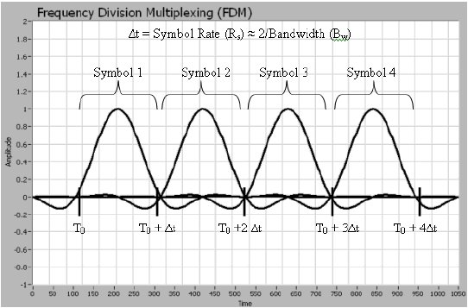
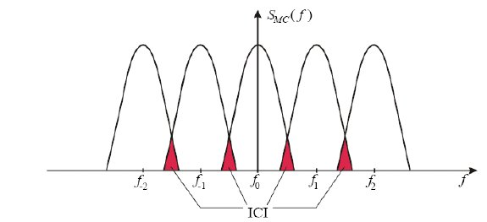
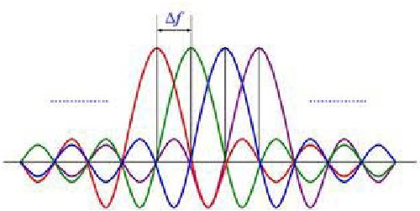
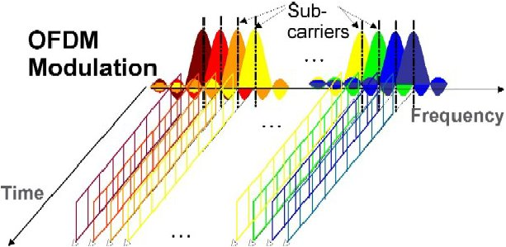
OFDM: Orthogonal Frequency Division Multiplexing
Traditional FDM
OFDM

Slide 17
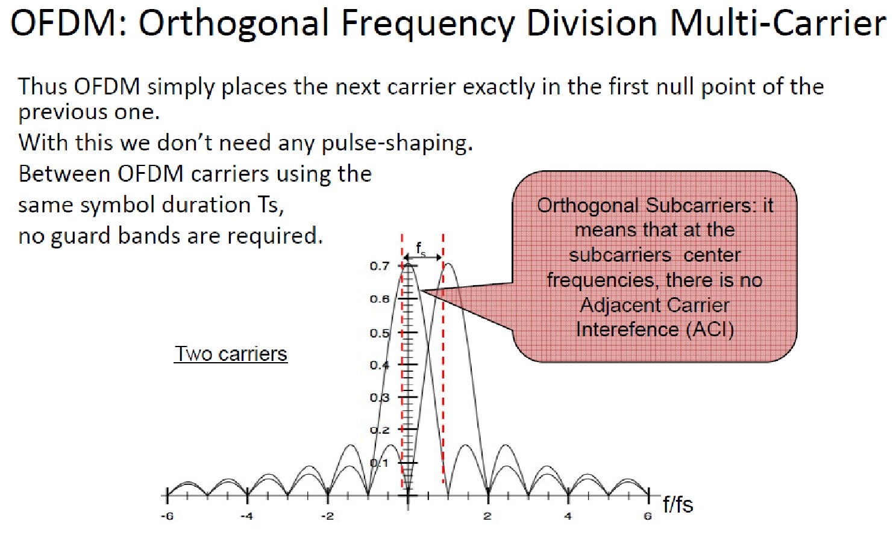

Slide 18
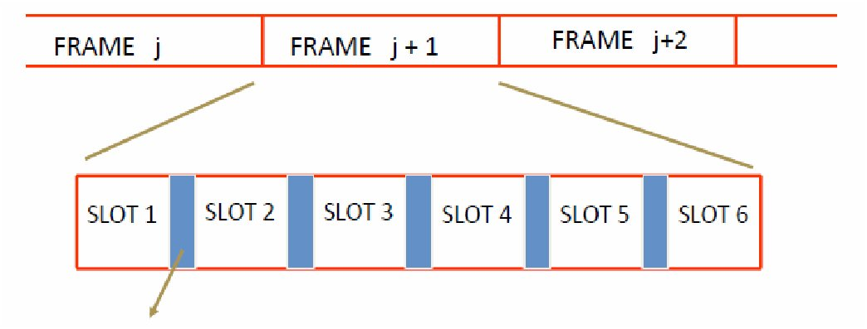
Time Division Multiple Access
Guard time – signal transmitted by mobile
terminals at different locations do no arrive
at the base station at the same time
• Time is divided into slots and only one mobile terminal transmits
during each slot
– Like during the lecture, only one can talk, but others may take the
floor in turn
• Each user is given a specific slot. No competition in cellular network
– Unlike Carrier Sensing Multiple Access (CSMA) in WiFi

Slide 19
Code Division Multiple Access (CDMA)
unique “code” assigned to each user; i.e., code set partitioning
  all users share same frequency, but each user has own “chipping” sequence (i.e., code) to encode data
  allows multiple users to “coexist” and transmit simultaneously with minimal interference (if codes are “orthogonal”)
encoded signal = (original data) X (chipping sequence)
decoding: inner-product of encoded signal and chipping sequence

Slide 20
CDMA encode/decode
channel output Z_{i,m}
Z_{i,m}= d_{i}.c_{m}
data
bits
d₀ = 1
1
1
1
1
1
d₁ = -1
1
1
1
-
-
-
-
1
-
-
-
1
-
1
1
1
1
1
sender
1
1
slot 1
channel
output
slot 0
channel
output
1
1
1
1
1
code
1
1
-
-
-
1
-
1
1
1
-
-
-
1
-
1
1
1
slot 1
slot 0
M
D_{i} = Σ Z_{i,m}.c_{m}
m=1
M
received
input
1
1
1
1
1
1
1
1
d₀ = 1
-
-
-
-
1
-
-
-
1
-
1
1
1
1
1
1
d₁ = -1
1
slot 1
channel
output
slot 0
channel
output
1
1
1
1
1
code
1
1
-
-
-
1
-
1
1
1
-
-
-
1
-
1
1
1
receiver
slot 1
slot 0

Slide 21

CDMA: two-sender interference
channel sums together transmissions by sender 1 and 2
Sender 1
Sender 2
using same code as sender 1, receiver recovers sender 1’s original data from summed channel data!

Slide 22




multiple access: CSMA-CA
avoid collisions: 2⁺ nodes transmitting at same time
802.11: CSMA - sense before transmitting
  don’t collide with ongoing transmission by other node
802.11: no collision detection!
  difficult to receive (sense collisions) when transmitting due to weak received signals (fading)
  can’t sense all collisions in any case: hidden terminal, fading
  goal: avoid collisions: CSMA/C(ollision)A(voidance)
A
B
C
C
B
A’s signal
strength
C’s signal
strength
A
space
Wireless, Mobile Networks
6-<number>

Slide 23
IEEE 802.11 MAC Protocol: CSMA/CA
802.11 sender
1 if sense channel idle for DIFS then
  transmit entire frame (no CD)
2 if sense channel busy then
  start random backoff time
  timer counts down while channel idle
  transmit when timer expires
  if no ACK, increase random backoff interval, repeat 2
802.11 receiver
- if frame received OK
return ACK after SIFS (ACK needed due to hidden terminal problem)
sender
receiver
DIFS
data
SIFS
ACK
Wireless, Mobile Networks
6-<number>

Slide 24
Avoiding collisions (more)
idea: allow sender to “reserve” channel rather than random access of data frames: avoid collisions of long data frames
sender first transmits small request-to-send (RTS) packets to BS using CSMA
  RTSs may still collide with each other (but they’re short)
BS broadcasts clear-to-send CTS in response to RTS
CTS heard by all nodes
  sender transmits data frame
  other stations defer transmissions
avoid data frame collisions completely
using small reservation packets!
Wireless, Mobile Networks
6-<number>

Slide 25

Collision Avoidance: RTS-CTS exchange
A
B
AP
RTS(B)
RTS(A)
reservation collision
RTS(A)
CTS(A)
CTS(A)
DATA (A)
defer
time
ACK(A)
ACK(A)
Wireless, Mobile Networks
6-<number>

Slide 26
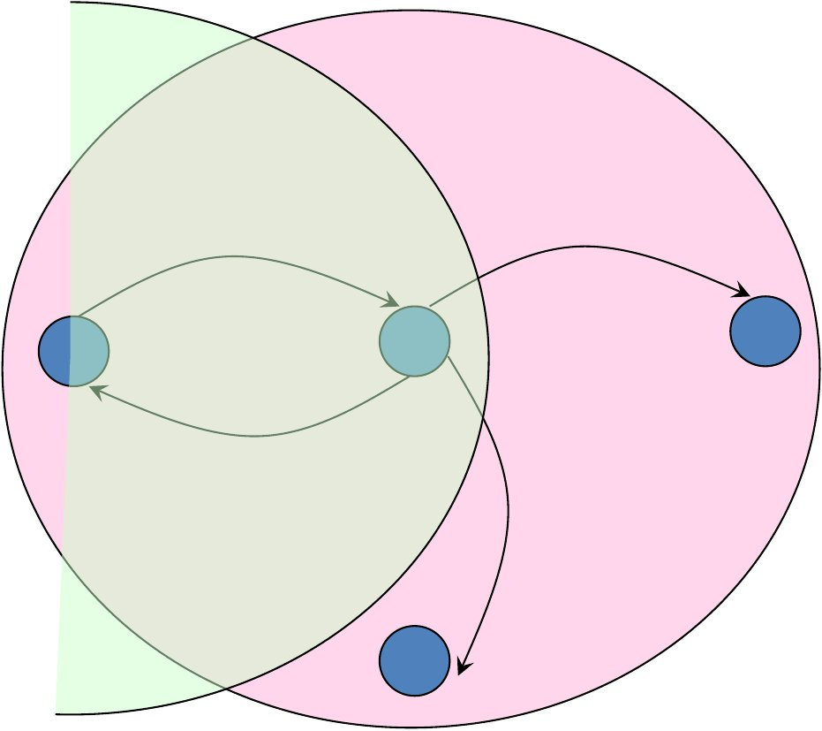
Collision avoidance in node B
RTS
CTS
B
C
A
CTS
CTS

Slide 27
Statistical multiplexing
Statistical multiplexing is a type of communication link sharing, very similar to dynamic bandwidth allocation (DBA). In statistical multiplexing, a communication channel is divided into an arbitrary number of variable bitrate digital channels or data streams. The link sharing is adapted to the instantaneous traffic demands of the data streams that are transferred over each channel. This is an alternative to creating a fixed sharing of a link, such as in general time division multiplexing (TDM) and frequency division multiplexing (FDM). When performed correctly, statistical multiplexing can provide a link utilization improvement, called the statistical multiplexing gain.
Statistical multiplexing is facilitated through packet mode or packet-oriented communication, which among others is utilized in packet switched computer networks. Each stream is divided into packets that normally are delivered asynchronously in a first-come first-served fashion. In alternative fashion, the packets may be delivered according to some scheduling discipline for fair queuing or differentiated and/or guaranteed quality of service.
Statistical multiplexing of an analog channel, for example a wireless channel, is also facilitated through the following schemes:
  Random frequency-hopping orthogonal frequency division multiple access (RFH-OFDMA)
  Code-division multiple access (CDMA), where different amount of spreading codes or spreading factors can be assigned to different users.
Statistical multiplexing normally implies "on-demand" service rather than one that preallocates resources for each data stream. Statistical multiplexing schemes do not control user data transmissions.
Wireless, Mobile Networks
6-<number>

Slide 28
Statistical multiplexing
Comparison with static TDM
Time domain statistical multiplexing (packet mode communication) is similar to time-division multiplexing (TDM), except that, rather than assigning a data stream to the same recurrent time slot in every TDM, each data stream is assigned time slots (of fixed length) or data frames (of variable lengths) that often appear to be scheduled in a randomized order, and experience varying delay (while the delay is fixed in TDM).
Statistical multiplexing allows the bandwidth to be divided arbitrarily among a variable number of channels (while the number of channels and the channel data rate are fixed in TDM).
Statistical multiplexing ensures that slots will not be wasted (whereas TDM can waste slots). The transmission capacity of the link will be shared by only those users who have packets.
Static TDM and other circuit switching is carried out at the physical layer in the OSI model and TCP/IP model, while statistical multiplexing is carried out at the data link layer and above.
Wireless, Mobile Networks
6-<number>

Slide 29
Spread spectrum techniques
In telecommunication and radio communication, spread-spectrum techniques are methods by which a signal (e.g., an electrical, electromagnetic, or acoustic signal) generated with a particular bandwidth is deliberately spread in the frequency domain, resulting in a signal with a wider bandwidth. These techniques are used for a variety of reasons, including the establishment of secure communications, increasing resistance to natural interference, noise, and jamming, to prevent detection, to limit power flux density (e.g., in satellite down links), and to enable multiple-access communications.
Spread spectrum generally makes use of a sequential noise-like signal structure to spread the normally narrowband information signal over a relatively wideband (radio) band of frequencies. The receiver correlates the received signals to retrieve the original information signal. Originally there were two motivations: either to resist enemy efforts to jam the communications (anti-jam, or AJ), or to hide the fact that communication was even taking place, sometimes called low probability of intercept (LPI).[1]
Frequency-hopping spread spectrum (FHSS), direct-sequence spread spectrum (DSSS), time-hopping spread spectrum (THSS), chirp spread spectrum (CSS), and combinations of these techniques are forms of spread spectrum. The first two of these techniques employ pseudorandom number sequences—created using pseudorandom number generators—to determine and control the spreading pattern of the signal across the allocated bandwidth. Wireless standard IEEE 802.11 uses either FHSS or DSSS in its radio interface.
Wireless, Mobile Networks
6-<number>

Slide 30
direct-sequence spread spectrum (DSSS)
In telecommunications, direct-sequence spread spectrum (DSSS) is a spread-spectrum modulation technique primarily used to reduce overall signal interference. The direct-sequence modulation makes the transmitted signal wider in bandwidth than the information bandwidth. After the despreading or removal of the direct-sequence modulation in the receiver, the information bandwidth is restored, while the unintentional and intentional interference is substantially reduced.
With DSSS, the message bits are modulated by a pseudorandom bit sequence known as a spreading sequence. Each spreading-sequence bit, which is known as a chip, has a much shorter duration (larger bandwidth) than the original message bits. The modulation of the message bits scrambles and spreads the pieces of data, and thereby results in a bandwidth size nearly identical to that of the spreading sequence. The smaller the chip duration, the larger the bandwidth of the resulting DSSS signal; more bandwidth multiplexed to the message signal results in better resistance against interference.
Some practical and effective uses of DSSS include the Code Division Multiple Access (CDMA) method, the IEEE 802.11b specification used in Wi-Fi networks, and the Global Positioning System.
Wireless, Mobile Networks
6-<number>

Slide 31
Frequency-hopping spread spectrum (FHSS)
Frequency-hopping spread spectrum (FHSS) is a method of transmitting radio signals by rapidly changing the carrier frequency among many distinct frequencies occupying a large spectral band. The changes are controlled by a code known to both transmitter and receiver. FHSS is used to avoid interference, to prevent eavesdropping, and to enable code-division multiple access (CDMA) communications.
The available frequency band is divided into smaller sub-bands. Signals rapidly change ("hop") their carrier frequencies among the center frequencies of these sub-bands in a predetermined order. Interference at a specific frequency will only affect the signal during a short interval. [1]
FHSS offers three main advantages over a fixed-frequency transmission:
  FHSS signals are highly resistant to narrowband interference because the signal hops to a different frequency band.
  Signals are difficult to intercept if the frequency-hopping pattern is not known.
  FHSS transmissions can share a frequency band with many types of conventional transmissions with minimal mutual interference. FHSS signals add minimal interference to narrowband communications, and vice versa.
Adaptive frequency-hopping spread spectrum (AFH) as used in Bluetooth improves resistance to radio frequency interference by avoiding crowded frequencies in the hopping sequence. This sort of adaptive transmission is easier to implement with FHSS than with DSSS.
Wireless, Mobile Networks
6-<number>

Slide 32
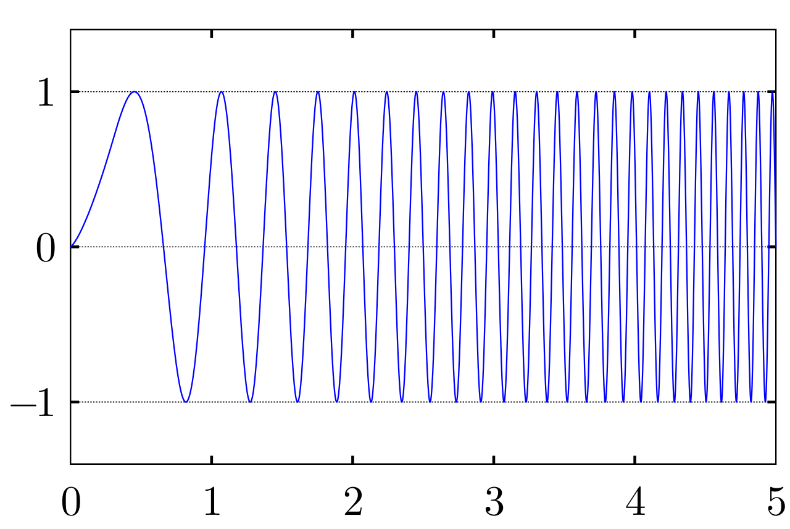
chirp spread spectrum (CSS)
In digital communications, chirp spread spectrum (CSS) is a spread spectrum technique that uses wideband linear frequency modulated chirp pulses to encode information. A chirp is a sinusoidal signal of frequency increase or decrease over time (often with a polynomial expression for the relationship between time and frequency). In the picture is an example of an upchirp in which the frequency increases linearly over time. Sometimes the frequency of upchirps increase exponentially over time.
As with other spread spectrum methods, chirp spread spectrum uses its entire allocated bandwidth to broadcast a signal, making it robust to channel noise. Further, because the chirps utilize a broad band of the spectrum, chirp spread spectrum is also resistant to multi-path fading even when operating at very low power. However, it is unlike direct-sequence spread spectrum (DSSS) or frequency-hopping spread spectrum (FHSS) in that it does not add any pseudo-random elements to the signal to help distinguish it from noise on the channel, instead relying on the linear nature of the chirp pulse. Additionally, chirp spread spectrum is resistant to the Doppler effect, which is typical in mobile radio applications.
Wireless, Mobile Networks
6-<number>

Slide 33
CSS and LoRa
Chirp spread spectrum is ideal for applications requiring low power usage and needing relatively low data rates (1 Mbit/s or less). In particular, IEEE 802.15.4a specifies CSS as a technique for use in Low-Rate Wireless Personal Area Networks (LR-WPAN).
LoRa (Long Range) is a low-power wide-area network (LPWAN) technology. It is based on spread spectrum modulation techniques derived from chirp spread spectrum (CSS) technology. LoRa uses license-free sub-gigahertz radio frequency bands like 433 MHz, 868 MHz (Europe), 915 MHz (Australia and North America) and 923 MHz (Asia). LoRa enables long-range transmissions (more than 10 km in rural areas) with low power consumption.[4] The technology covers the physical layer, while other technologies and protocols such as LoRaWAN (Long Range Wide Area Network) cover the upper layers.
LoRa uses a proprietary spread spectrum modulation that is similar to and a derivative of Chirp spread spectrum (CSS) modulation. The spread spectrum LoRa modulation is performed by representing each bit of payload information by multiple chirps of information. The rate at which the spread information is sent is referred to as the symbol rate, the ratio between the nominal symbol rate and chirp rate is the spreading factor (SF) and represents the number of symbols sent per bit of information.[1] LoRa can trade off data rate for sensitivity with a fixed channel bandwidth by selecting the amount of spread used (a selectable radio parameter from 7 to 12). Lower SF means more chirps are sent per second; hence, you can encode more data per second. Higher SF implies fewer chirps per second; hence, there are fewer data to encode per second. Compared to lower SF, sending the same amount of data with higher SF needs more transmission time, known as airtime. More airtime means that the modem is up and running longer and consuming more energy. The benefit of high SF is that more extended airtime gives the receiver more opportunities to sample the signal power which results in better sensitivity.
Wireless, Mobile Networks
6-<number>

Slide 34
ISM Band
The industrial, scientific and medical (ISM) radio bands are radio bands (portions of the radio spectrum) reserved internationally for the use of radio frequency (RF) energy for industrial, scientific and medical purposes other than telecommunications. Examples of applications in these bands include radio-frequency process heating, microwave ovens, and medical diathermy machines. The powerful emissions of these devices can create electromagnetic interference and disrupt radio communication using the same frequency, so these devices were limited to certain bands of frequencies. In general, communications equipment operating in these bands must tolerate any interference generated by ISM applications, and users have no regulatory protection from ISM device operation.
Despite the intent of the original allocations, in recent years the fastest-growing uses of these bands have been for short-range, low power wireless communications systems, since these bands can be used without a government license, as is required for transmitters on other frequencies. Cordless phones, Bluetooth devices, near field communication (NFC) devices, garage door openers, baby monitors and wireless computer networks (WiFi) all use the ISM frequencies, although these low power emitters are not considered ISM.

Slide 35
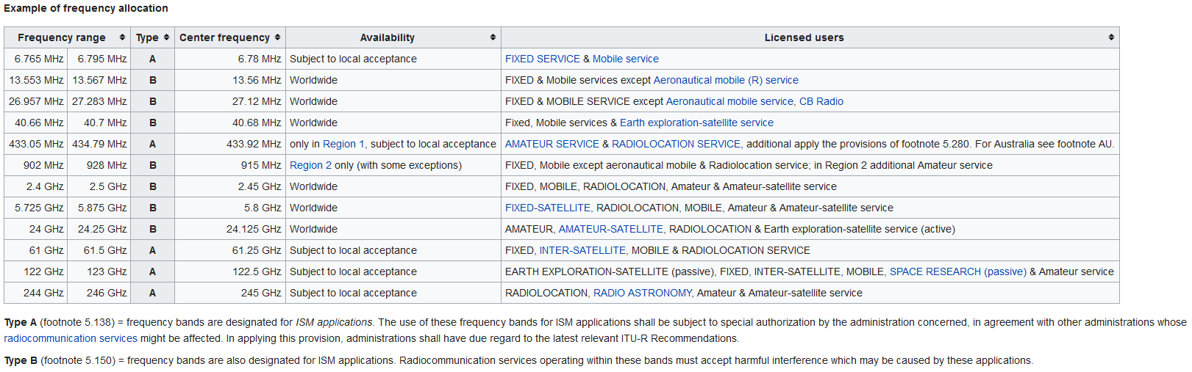
ISM Band

Slide 36
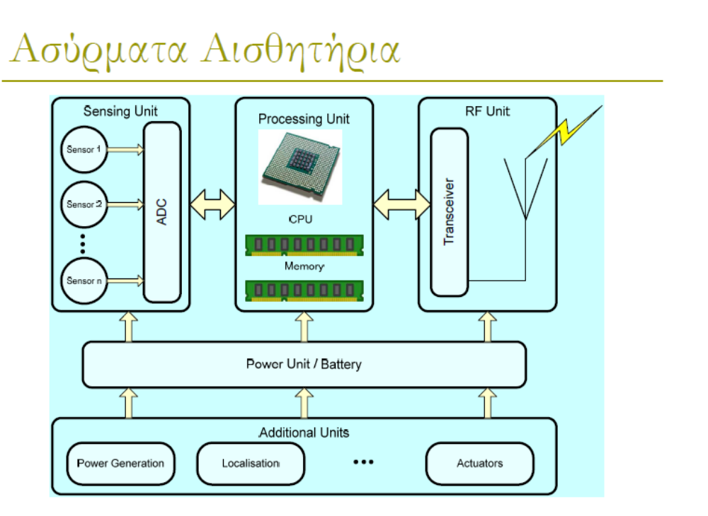

Slide 37
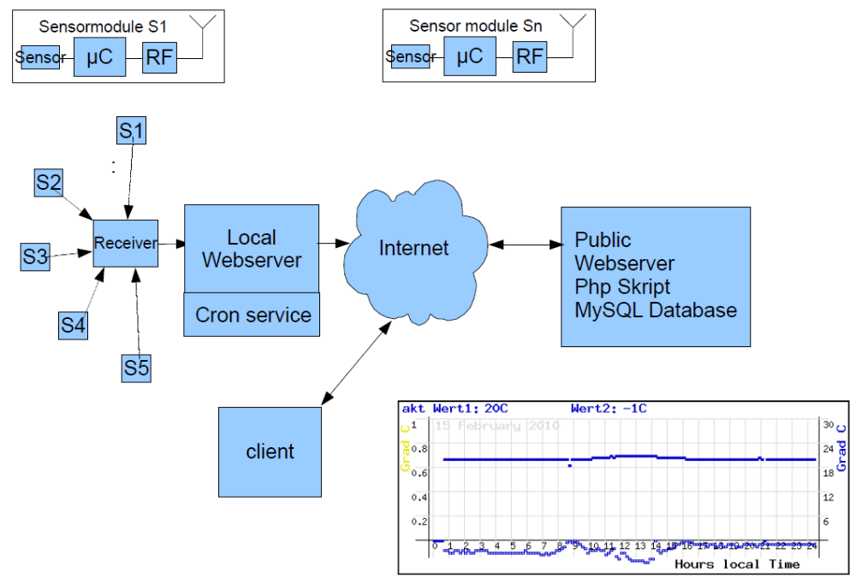

Slide 38
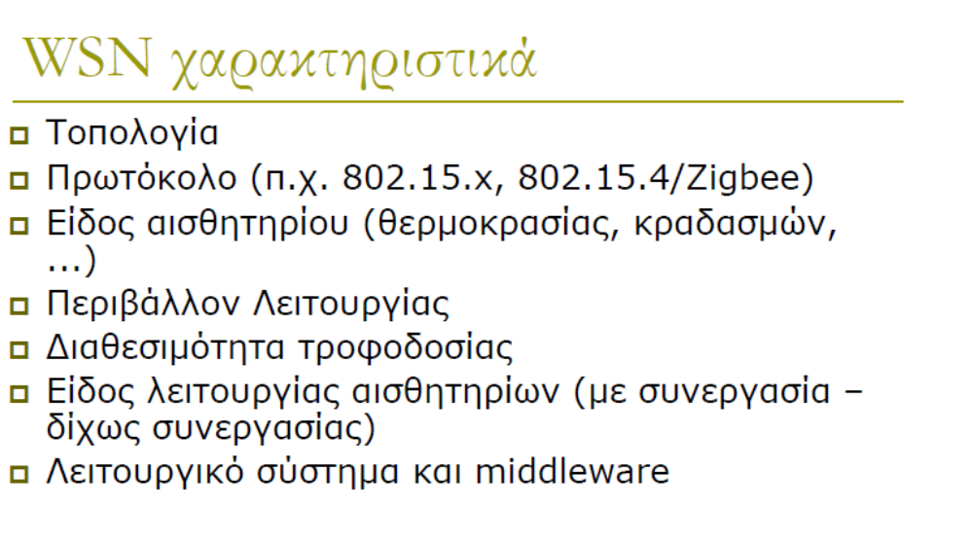

Slide 39
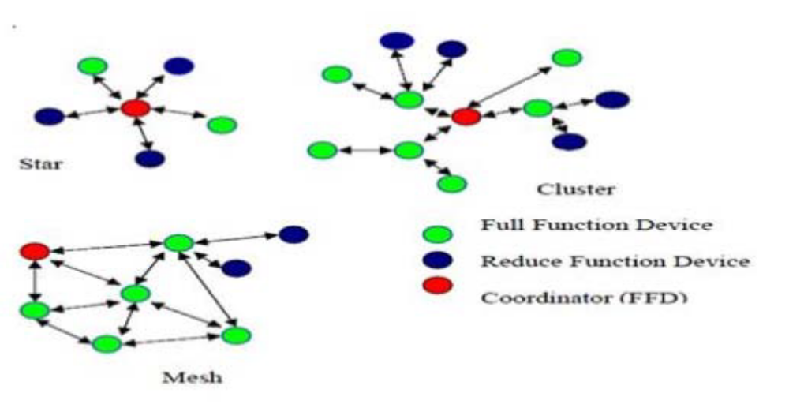
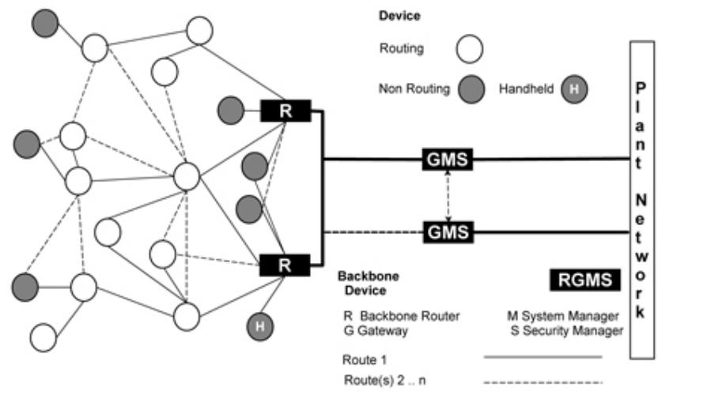
WSN Topologies

Slide 40
advanced capabilities
power management
node-to-AP: “I am going to sleep until next beacon frame”
  AP knows not to transmit frames to this node
  node wakes up before next beacon frame
beacon frame: contains list of mobiles with AP-to-mobile frames waiting to be sent
  node will stay awake if AP-to-mobile frames to be sent; otherwise sleep again until next beacon frame

Slide 41
WSN Routing protocols
Routing Protocol for Low power and Lossy Networks (RPL) is a distance vector routing protocol, here the routing is based on Destination oriented Acyclic graphs or DODAGs.
https://zaidmufti.wordpress.com/2016/08/18/what-is-rpl-and-how-to-simulate-it-in-cooja/
Wireless, Mobile Networks
6-<number>

Slide 42
802.15: personal area network
less than 10 m diameter
replacement for cables (mouse, keyboard, headphones)
ad hoc: no infrastructure
master/slaves:
  slaves request permission to send (to master)
  master grants requests
802.15: evolved from Bluetooth specification
  2.4-2.5 GHz radio band
  up to 721 kbps
S
P
P
radius of
coverage
M
S
S
P
P
M
Master device
Slave device
Parked device (inactive)
S
P

Slide 43
IEEE 802.15.4 protocol
The IEEE standard 802.15.4 is suitable for low-cost, low-speed, low-power wireless, short-range personal area networks (WPANs). It only provides access control for the MAC and PHY layers. It can be used at the home networking, industrial networks, interactive toys etc.
There are various versions of the 802.15.4 protocol and related to changes in the physical level.
The standard 802.15.4 versions are:

Slide 44
IEEE 802.15.4 protocol
The IEEE 802.15.4 physical layer is responsible for:
  Activation and deactivation of the radio transceiver
  Energy detection within the current channel
  Link quality indication for received packets
  Clear channel assessment (CCA) for CSMA/CA
  Channel frequency selection
  Data transmission and reception.
At the band of 2,400–2,483.5 MHz, the modulation that used is the O-QPSK and BPSK.

Slide 45
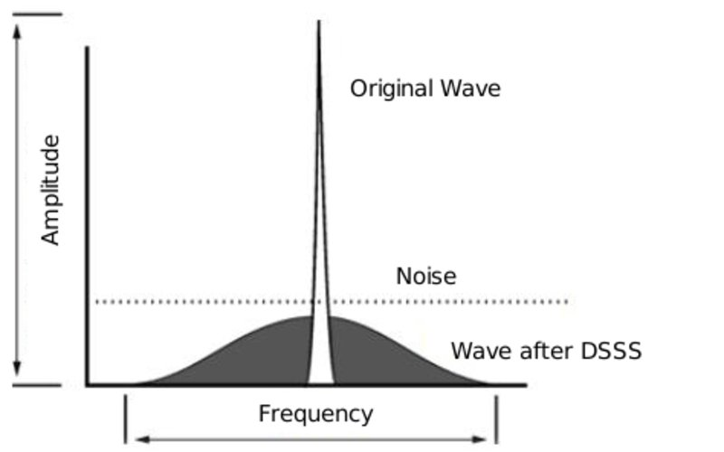
IEEE 802.15.4 protocol
The IEEE 802.15.4 is good against the noise. This is happened because is used Direct Sequence Spread Spectrum (DSSS) to modulate the information before being sent to the physical layer. This process causes the total information to be transmitted to occupy a larger bandwidth but it uses a lower spectral power density for each signal.

Slide 46

IEEE 802.15.4 protocol
Three different network operations there are in 802.15.4:
  the star topology,
  the mesh and tree topology
  the cluster topology.
In star topology all nodes communicate via the central PAN coordinator.
In mesh and tree topology all nodes are full function devices.
In cluster topology we have a number of star topologies which connect each other. For an example, cluster nodes exist between rooms of a hotel and each room has a star network for control.

Slide 47
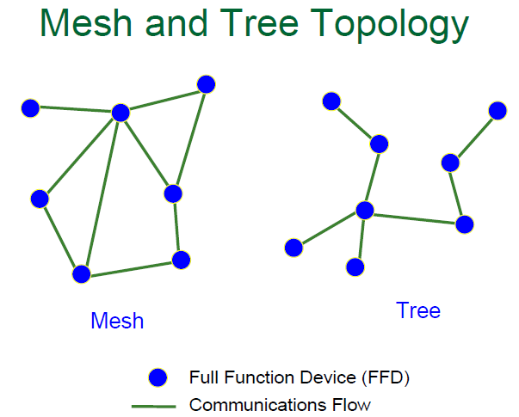
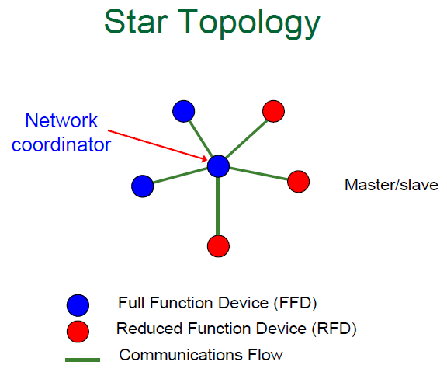
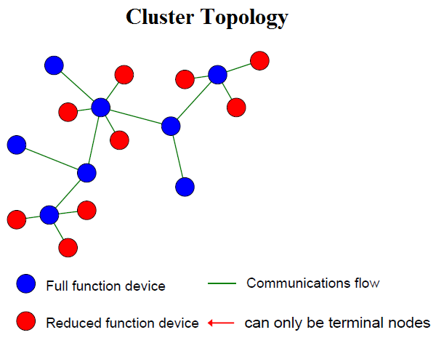
IEEE 802.15.4 protocol
Network operation

Slide 48
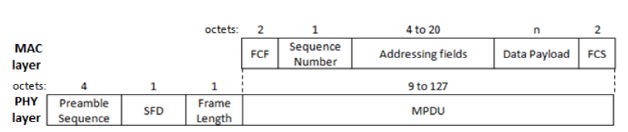
IEEE 802.15.4 protocol
The MAC layer defines four different frame types:
  Beacon frame ⤇ synchronization mechanism
  Acknowledgment frames ⤇ identify emissions
  MAC command frames ⤇ execute orders of the protocol
  such as "connection request" or "data request".
  Data frames ⤇ used for all data transfers

Slide 49
IEEE 802.15.4 protocol
The 802.15.4 is good against interferences, because it uses two techniques to avoid all the nodes start emitting at the same time: CSMA-CA and GTS. In the CSMA-CA method each node listen the medium prior to transmit. In the Guarantee Time Slots (GTS) method uses a centralized node which gives slots of time to each node so that any knows when they have to transmit. There are 16 possible slots of time.
Applications
ZigBee
Wireless HART: It is the wireless version of the HART protocol which is the most used in the automation and industrial applications which require real time.
ISA - SP100: It also centers in the process and factory automation.
IETF IPv6 - LoWPAN: It is the implementation of the IPv6 stack on top of 802.15.4 to let any device be accessible and access from and to Internet.
MiWi protocol: Its stacks are small foot-print alternatives to ZigBee, appropriate for cost-sensitive applications with limited memory. Its software is free.
WSN Παντελάκη Καλλιόπη

Slide 50
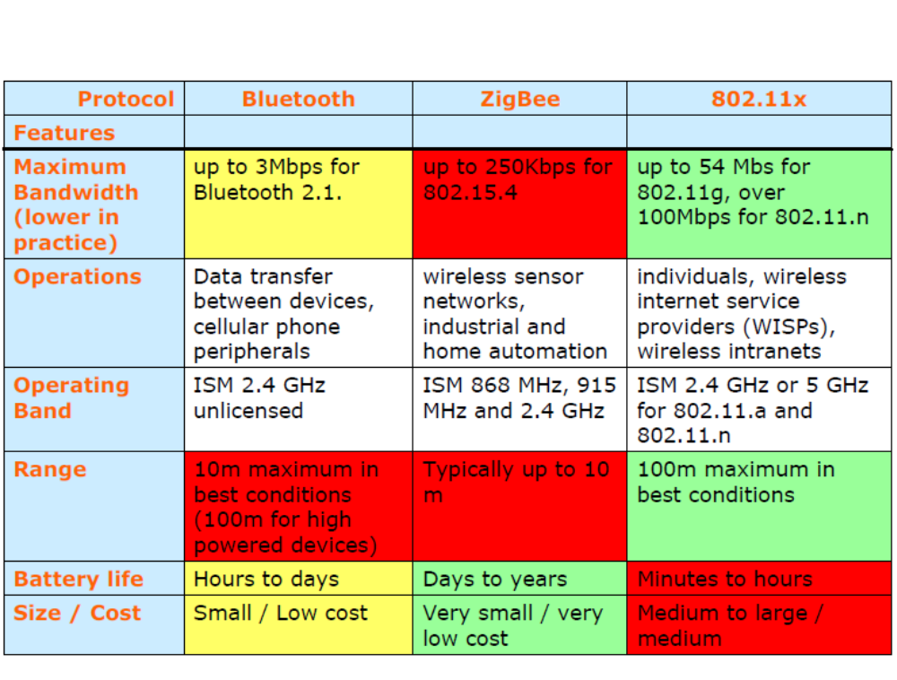

Slide 51
RadioHead Packet Radio library for embedded microprocessors
It provides a complete object-oriented library for sending and receiving packetized messages via a variety of common data radios and other transports on a range of embedded microprocessors.
RadioHead consists of 2 main sets of classes: Drivers and Managers.
Drivers provide low level access to a range of different packet radios and other packetized message transports.
Managers provide high level message sending and receiving facilities for a range of different requirements.
Every RadioHead program will have an instance of a Driver to provide access to the data radio or transport, and usually a Manager that uses that driver to send and receive messages for the application. The programmer is required to instantiate a Driver and a Manager, and to initialise the Manager. Thereafter the facilities of the Manager can be used to send and receive messages.
It is also possible to use a Driver on its own, without a Manager, although this only allows unaddressed, unreliable transport via the Driver's facilities.
In some specialised use cases, it is possible to instantiate more than one Driver and more than one Manager.
Any Manager may be used with any Driver.
A range of different common embedded microprocessor platforms are supported, allowing your project to run on your choice of processor.
Wireless, Mobile Networks
6-<number>

Slide 52
Radio lib - Universal wireless communication library for Arduino
RadioLib allows its users to integrate all sorts of different wireless communication modules into a single consistent system. Want to add a Bluetooth interface to your ZigBee network? Sure thing! Need to connect LoRa network to the Internet with a GSM module? RadioLib has got your back!
RadioLib was originally created as a driver for RadioShield, but it can be used to control as many different wireless modules as you like - or at least as many as your Arduino can handle!
Supported modules:
CC1101 FSK radio module
ESP8266 WiFi module
HC05 Bluetooth module
JDY08 BLE module
nRF24L01 2.4 GHz module
RF69 FSK/OOK radio module
RFM2x series FSK modules
RFM9x series LoRa modules
Si443x series FSK modules
SX127x series LoRa modules
SX126x series LoRa modules
SX1231 FSK/OOK radio module
XBee modules (S2B)
Supported protocols:
MQTT for modules: ESP8266
HTTP for modules: ESP8266
RTTY for modules: SX127x, RFM9x, SX126x, RF69, SX1231, CC1101, nRF24L01, RFM2x and Si443x
Morse Code for modules: SX127x, RFM9x, SX126x, RF69, SX1231, CC1101, nRF24L01, RFM2x and Si443x
AX.25 for modules: SX127x, RFM9x, SX126x, RF69, SX1231, CC1101, RFM2x and Si443x
SSTV for modules: SX127x, RFM9x, SX126x, RF69 and SX1231
Wireless, Mobile Networks
6-<number>

